Slide 1
K means clustering
Classification of clustering methods
Partitioning method: K – means clustering

Slide 2
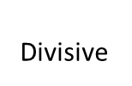
Classification of Clustering Methods
Clustering Methods
Partitioning
Hierarchical
K-Means
k-Medoids
Agglomerative

Slide 3
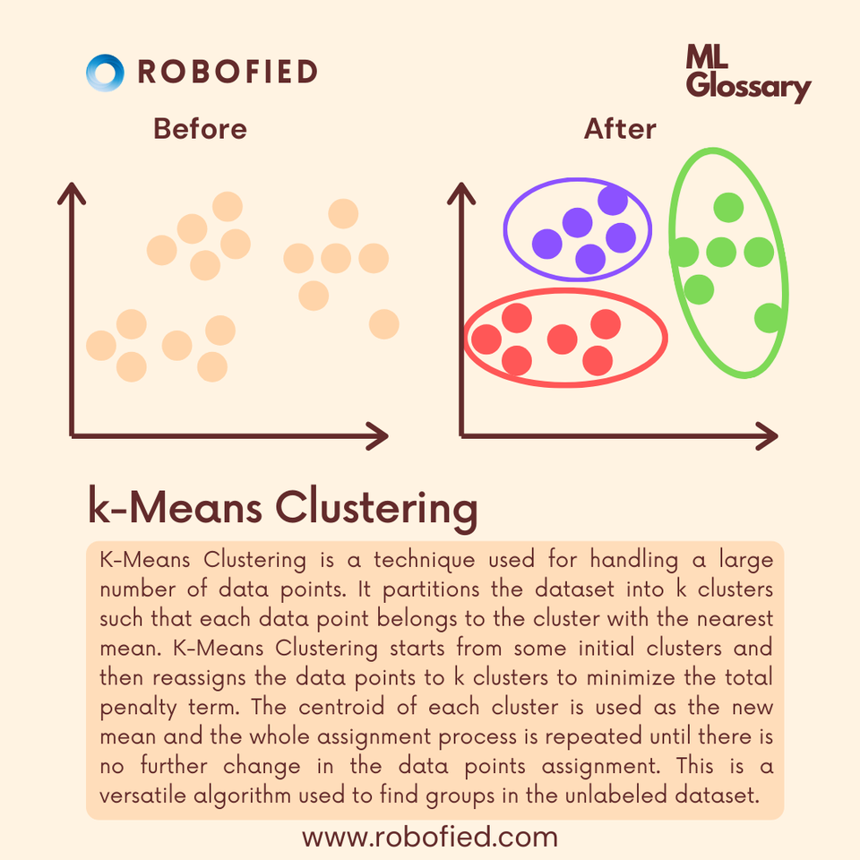

Slide 4
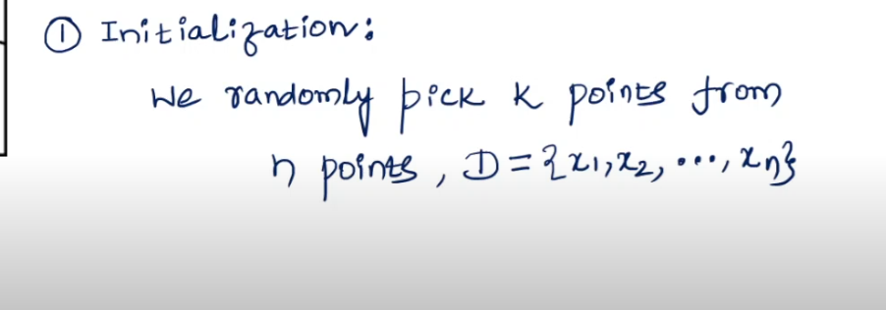
K-means clustering steps

Slide 5
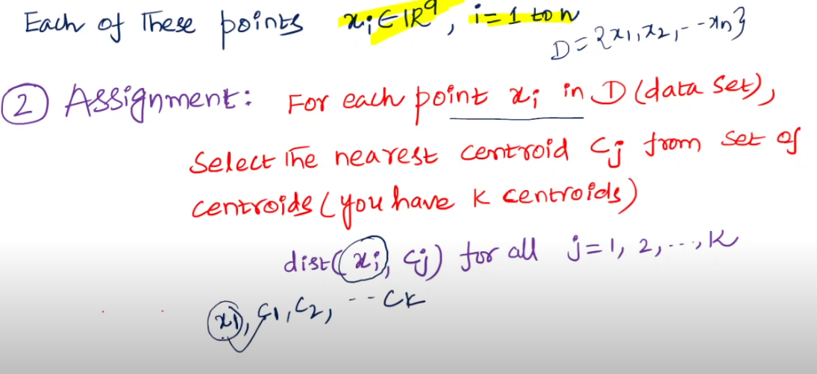

Slide 6
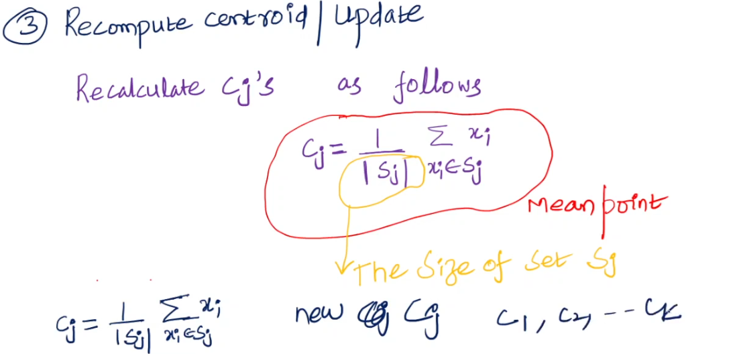

Slide 7
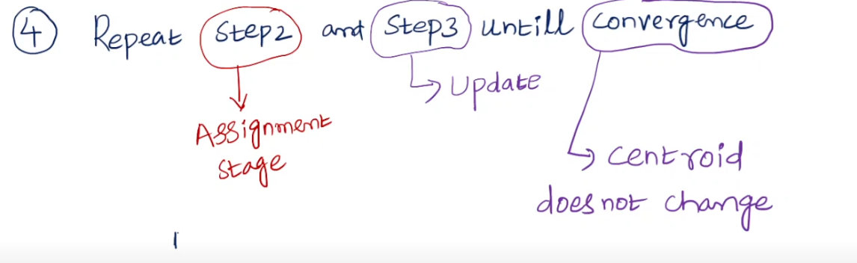

Slide 8
Which Clustering Algorithm to Choose
The choice of a clustering algorithm depends on
  Type of data available
  Particular purpose
It is permissible to try several algorithms on the same data, because cluster analysis is mostly used as a descriptive or exploratory tool

Slide 9
Partitioning Method
Given -
a data set of n objects
k, the number of clusters
A partitioning algorithm organizes the objects into k partitions (k ≤ n), where each partition represents a cluster.
The clusters are formed to optimize an objective partitioning criterion
Objective partitioning criterion such as a dissimilarity function based on distance
Therefore, the objects within a cluster are “similar,” whereas the objects
of different clusters are “dissimilar” in terms of the data set attributes.

Slide 10
Partitioning Method
Partitioning methods are applied if one wants to classify the objects into k
clusters, where k is fixed ( k is the number of

Slide 11
K-Means Method
It is a centroid based technique
The k-means algorithm takes the input parameter, k, and partitions a set of n objects into k clusters
So that the resulting intra-cluster similarity is high but the inter-cluster similarity is low
Cluster similarity is measured in regard to the mean value of the objects in
a cluster, which can be viewed as the cluster’s centroid or center of gravity

Slide 12
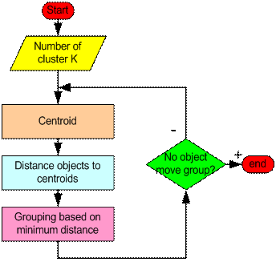
Working Principle of K-Means Algorithm

Slide 13
Working Principle of K-Means Algorithm
First it randomly selects k of the objects, each of which initially represents a cluster mean or center
For each of the remaining objects, an object is assigned to the cluster to which it is the most similar, based on the distance between the object and the cluster mean
It then computes the new mean for each cluster
This process iterates until the criterion function converges

Slide 14
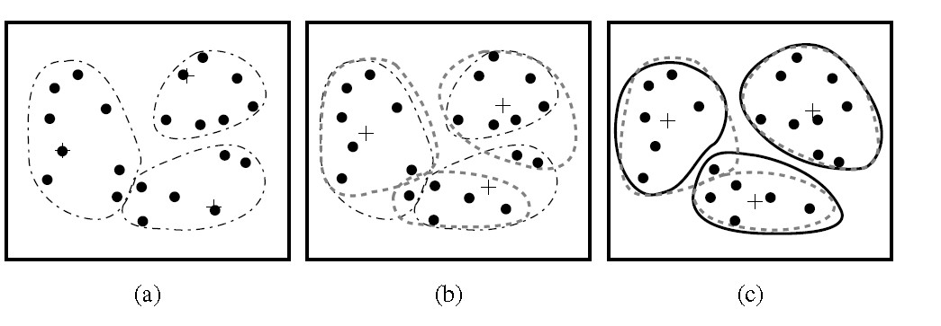
K = 3

Slide 15
K-Means Clustering Algorithm
Algorithm: k-means. The k-means algorithm for partitioning, where each
cluster’s center is represented by the mean value of the objects in the cluster.
Input:
k: the number of clusters,
D: a data set containing n objects.
Output: A set of k clusters.

Slide 16
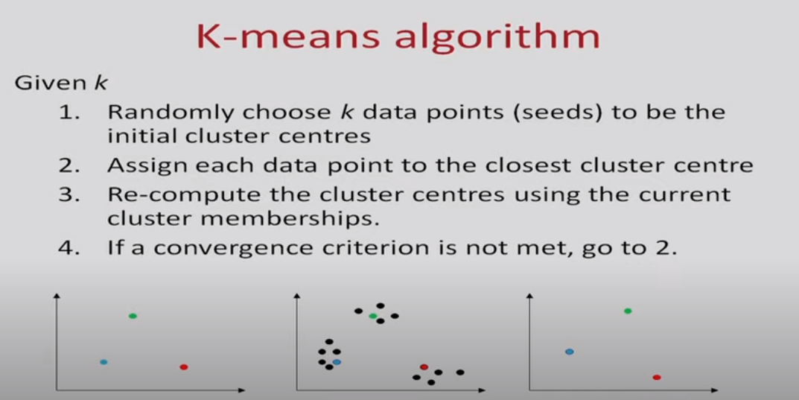

Slide 17
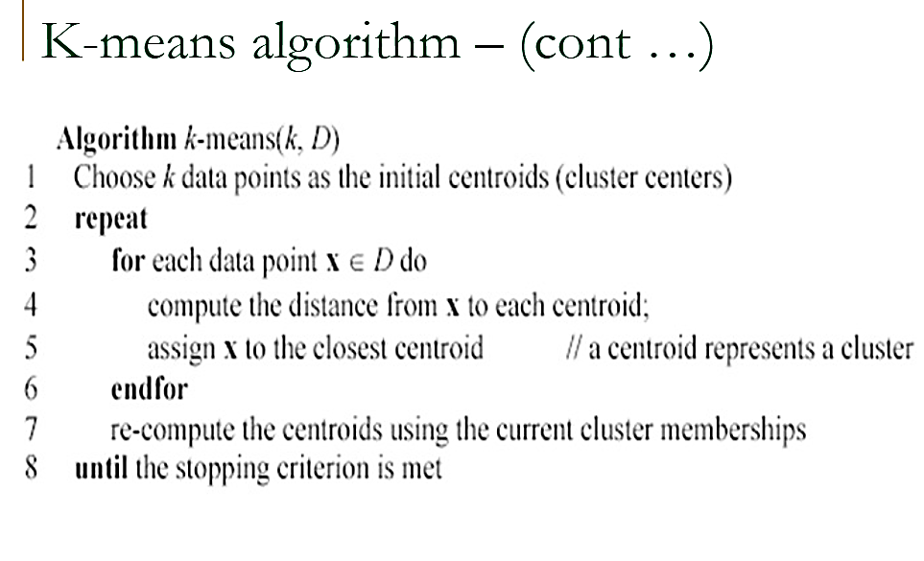

Slide 18
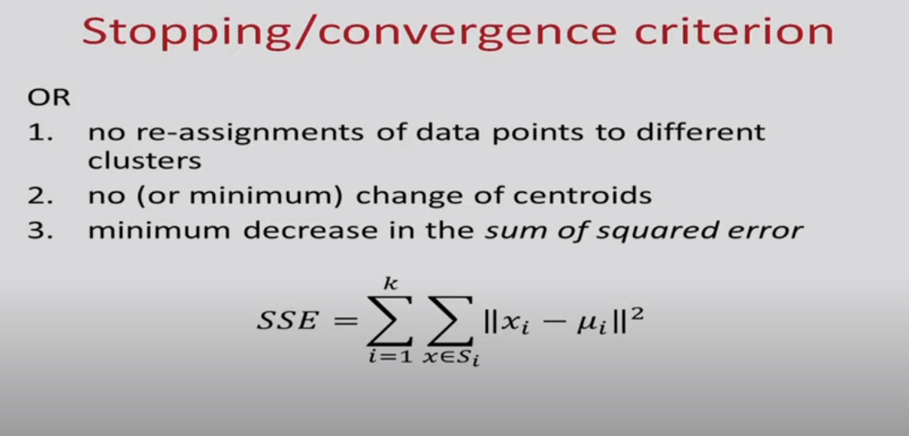
Minimize
Also called within cluster sum of squares

Slide 19
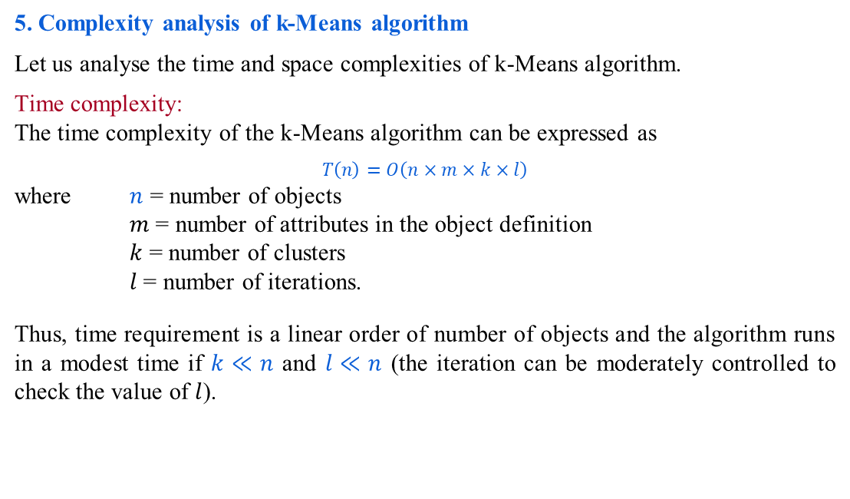
Comments on k-Means algorithm
5. Complexity analysis of k-Means algorithm
Let us analyse the time and space complexities of k-Means algorithm.
Time complexity:
The time complexity of the k-Means algorithm can be expressed as
$$T\left(n\right)=O\left(n×m×k×l\right)$$
where $n$ = number of objects
$m$= number of attributes in the object definition
$k$ = number of clusters
$l$= number of iterations.
Thus, time requirement is a linear order of number of objects and the algorithm runs in a modest time if $k≪n$ and $l≪n$ (the iteration can be moderately controlled to check the value of $l$).

Slide 20
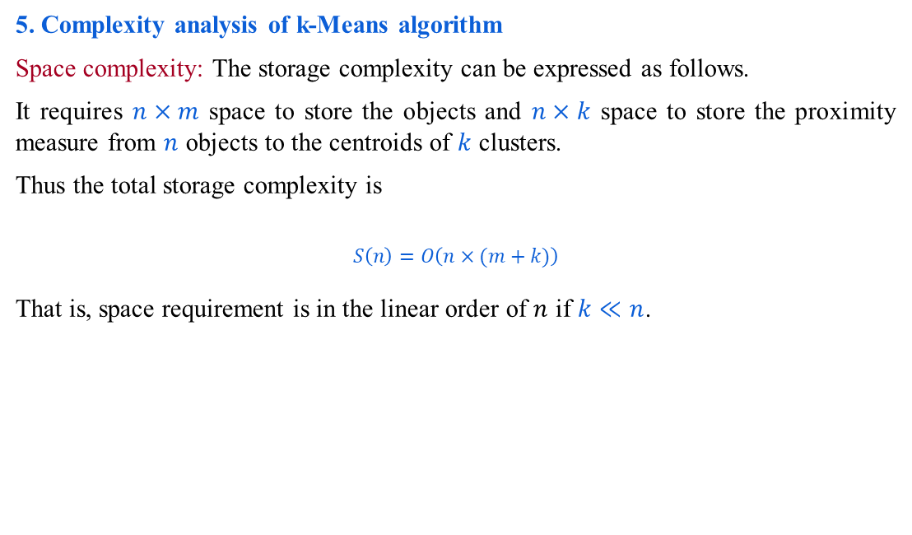
Comments on k-Means algorithm
5. Complexity analysis of k-Means algorithm
Space complexity: The storage complexity can be expressed as follows.
It requires $n×m$ space to store the objects and $n×k$ space to store the proximity measure from $n$ objects to the centroids of $k$ clusters.
Thus the total storage complexity is
$$S\left(n\right)=O\left(n×(m+k)\right)$$
That is, space requirement is in the linear order of $n$ if $k≪n$.

Slide 21
Advantages of K means
Fast and robust easy to understand.
Relatively efficient.
Gives best result when data set are distinct or well separated from each other.
These methods are generally less computationally intensive and are therefore preferred with very large datasets.

Slide 22
Advantages of K means
Fast and robust easy to understand.
Relatively efficient.
Gives best result when data set are distinct or well separated from each other.
These methods are generally less computationally intensive and are therefore preferred with very large datasets.

Slide 23
Advantages of K means
Relatively simple to implement.
Scales to large data sets.
Guarantees convergence.
Can warm-start the positions of centroids.
Easily adapts to new examples.
Generalizes to clusters of different shapes and sizes, such as elliptical clusters.

Slide 24
Disadvantages of K means
K Means clustering requires prior knowledge of K i.e. no. of clusters one want to divide your data into
Hard assignment of data points of clusters.
Applicable only when mean is defined, fails for categorical data
Sensitive to noise/outliers
The algorithm is sensitive to initial seed
In K Means clustering, since one start with random choice of clusters, the results produced by running the algorithm multiple times might differ.
K Means is found to work well when the shape of the clusters is hyper spherical (like circle in 2D, sphere in 3D) but not with Non-globular Shapes.
K-means has problems when clusters are of differing
  Sizes
  Densities
  Non-globular shapes
Notes:
k-means has trouble clustering data that contains outliers. When the SSE is used as objective function, outliers can unduly influence the cluster that are produced. More precisely, in the presence of outliers, the cluster centroids, in fact, not truly as representative as they would be otherwise. It also influence the SSE measure as well.

Slide 25
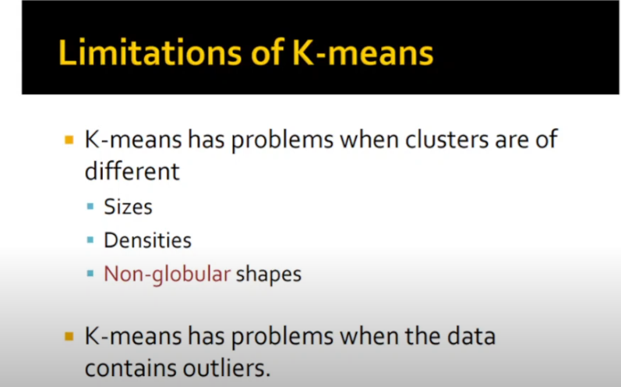

Slide 26
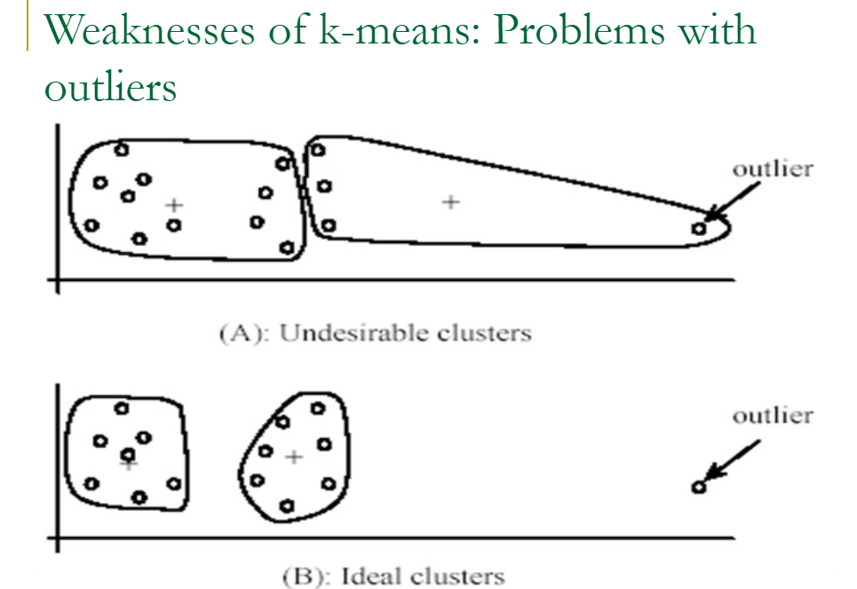

Slide 27
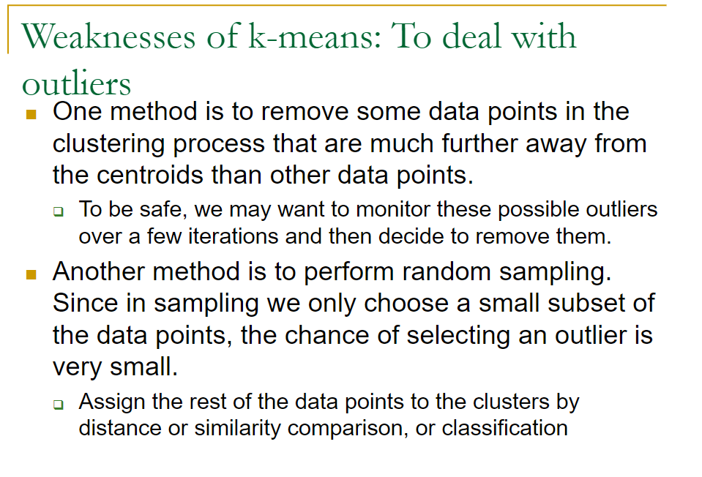

Slide 28
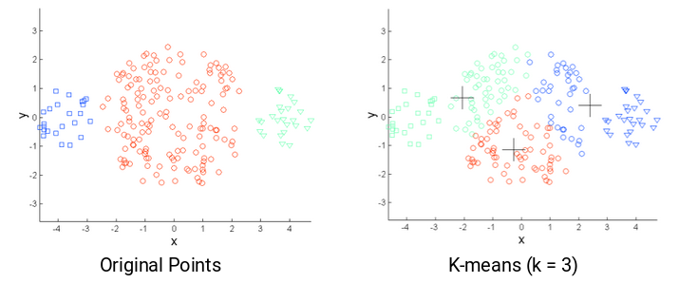
Limitation of k-means: Different sizes

Slide 29
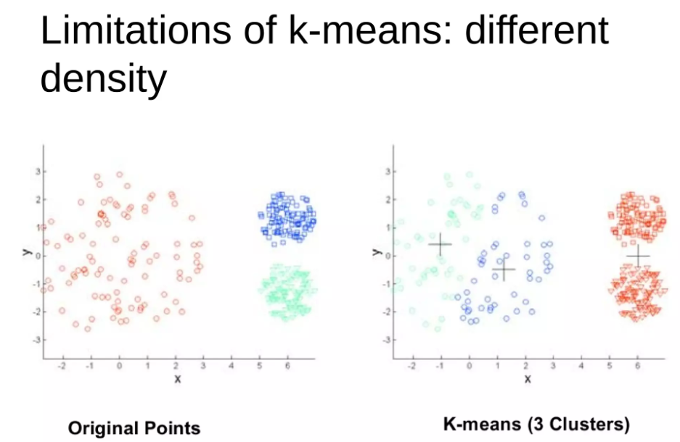

Slide 30
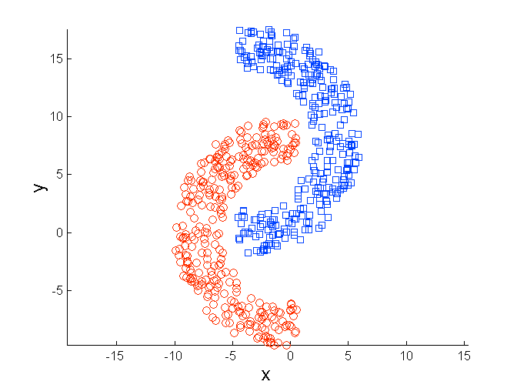
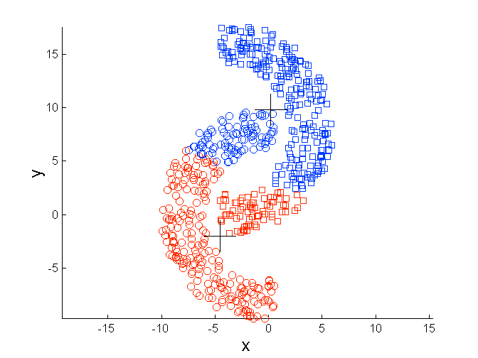
Limitations of K-means: Non-globular Shapes
Original Points
K-means (2 Clusters)

Slide 31
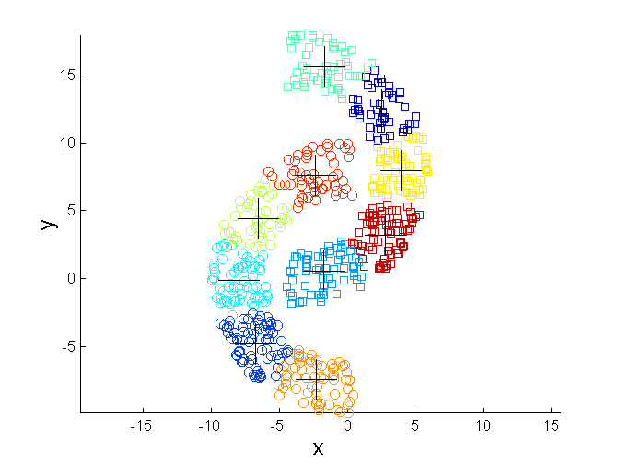
Overcoming K-means Limitations
Original Points K-means Clusters
One solution is to find a large number of clusters such that each of them represents a part of a natural cluster. But these small clusters need to be put together in a post-processing step.

Slide 32
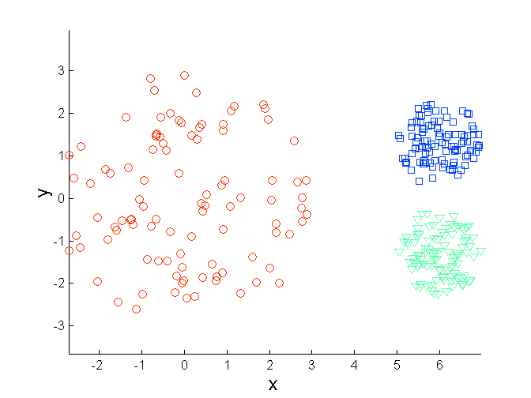
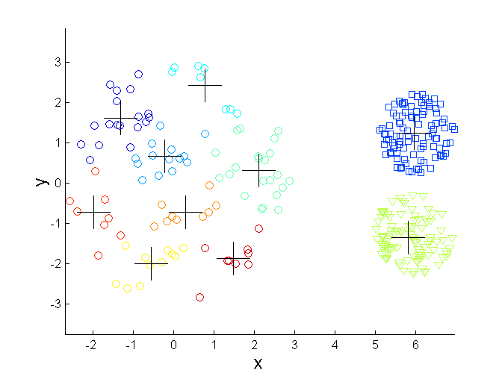
Overcoming K-means Limitations
Original Points K-means Clusters
One solution is to find a large number of clusters such that each of them represents a part of a natural cluster. But these small clusters need to be put together in a post-processing step.

Slide 33
K-Means clustering example: Numerical
Individual | Variable 1 | Variable 2
1 | 1.0 | 1.0
2 | 1.5 | 2.0
3 | 3.0 | 4.0
4 | 5.0 | 7.0
5 | 3.5 | 5.0
6 | 4.5 | 5.0
7 | 3.5 | 4.5

Slide 34
K-Means clustering example k has to be given to the algorithm, assume k=2
8.00
4
7.00
6.00
Variable 2
5
6
5.00
3
7
4.00
3.00
2
2.00
1
1.00
0.00
0.00
1.00
2.00
3.00
4.00
5.00
6.00
Variable 1

Slide 35
K-Means clustering example
Initialization: Randomly we choose following two centroids (k=2) for two clusters. In this case the 2 centroid are:
Cluster | Var1 | Var2
K1 | 1.0 | 1.0
K2 | 3.0 | 4.0
Individual | Variable 1 | Variable 2
1 | 1.0 | 1.0
2 | 1.5 | 2.0
3 | 3.0 | 4.0
4 | 5.0 | 7.0
5 | 3.5 | 5.0
6 | 4.5 | 5.0
7 | 3.5 | 4.5
Calculate Euclidean distance using the given equation
Distance [(𝑥₁, 𝑦₁), (𝑥₂, 𝑦₂)] =
(𝑥₂ − 𝑥₁)² + (𝑦₂ − 𝑦₁)²

Slide 36
K-Means clustering example k has to be given to the algorithm, assume k=2
8.00
4
7.00
6.00
Variable 2
5
6
5.00
3
7
4.00
3.00
2
2.00
1
1.00
0.00
0.00
1.00
2.00
3.00
4.00
5.00
6.00
Variable 1

Slide 37

K-Means clustering example
Distance of k1 from k1 (1.0, 1.0) = (1.0 − 1.0)² + (1.0 − 1.0)² = 0
k1 to k2 (1.0, 1.0), (3.0, 4.0) = (3.0 − 1.0)² + (4.0 − 1.0)² = 3.61
Distance of k 2 from k2 (3.0, 4.0) = (3.0 − 3.0)² + 4.0 − 4.0 ² = 0
Indivi dual | Variab le 1 | Variab le 2
1 | 1.0 | 1.0
2 | 1.5 | 2.0
3 | 3.0 | 4.0
4 | 5.0 | 7.0
5 | 3.5 | 5.0
6 | 4.5 | 5.0
7 | 3.5 | 4.5
Cluster | Centroid
 | K1 | K2 | Assignment
K1 | 0 | 3.61 | k1
K2 | 3.61 | 0 | k2

Slide 38
At K = 2
Variable 2
8.00
4
7.00
6.00
5
6
5.00
3
7
4.00
3.00
2
2.00
1
1.00
0.00
0.00
1.00
2.00
3.00
4.00
5.00
6.00

Slide 39

K-Means clustering example
Individual | Variable 1 | Variable 2
1 | 1.0 | 1.0
2 | 1.5 | 2.0
3 | 3.0 | 4.0
4 | 5.0 | 7.0
5 | 3.5 | 5.0
6 | 4.5 | 5.0
7 | 3.5 | 4.5
Calculate Euclidean distance for next data point (1.5, 2.0)
Distance from cluster1 = Distance from cluster2 =
(1.5 − 1.0) + (2.0 − 1.0) = 1.12
(1.5 − 3.0)² + (2.0 − 4.0)² = 2.5
2 2
Dataset | Euclidean Distance
 | Cluster 1 | Cluster 2 | Assignment
(1.5, 2.0) | 1.12 | 2.5 | k1

Slide 40
8.00
4
7.00
6.00
5
6
5.00
3
7
4.00
3.00
2
2.00
1
1.00
0.00
0.00
1.00
2.00
3.00
4.00
5.00
6.00

Slide 41
K-Means clustering example
Update the cluster centroid
Cluster | Var1 | Var2
K1 | (1.0 + 1.5)/2 = 1.25 | (1.0 + 2.0)/2 = 1.5
K2 | 3.0 | 4.0
Indivi dual | Variab le 1 | Variab le 2
1 | 1.0 | 1.0
2 | 1.5 | 2.0
3 | 3.0 | 4.0
4 | 5.0 | 7.0
5 | 3.5 | 5.0
6 | 4.5 | 5.0
7 | 3.5 | 4.5

Slide 42
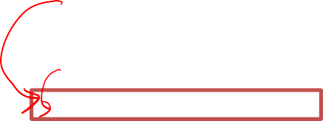


K-Means clustering example
Individual | Variable 1 | Variable 2
1 | 1.0 | 1.0
2 | 1.5 | 2.0
3 | 3.0 | 4.0
4 | 5.0 | 7.0
5 | 3.5 | 5.0
6 | 4.5 | 5.0
7 | 3.5 | 4.5
Calculate Euclidean distance for next dataset (5.0, 7.0)
Distance from cluster1 = Distance from cluster2 =
(5.0 − 1.25) + (7.0 − 1.5) = 6.66
(5.0 − 3.0)² + (7.0 − 4.0)² = 3.61
2 2
Dataset | Euclidean Distance
 | Cluster 1 | Cluster 2 | Assignment
(5.0, 7.0) | 6.66 | 3.61 | K-2

Slide 43
Variable 2
8.00
4
7.00
6.00
5
6
5.00
3
7
4.00
3.00
2
2.00
1
1.00
0.00
0.00
1.00
2.00
3.00
4.00
5.00
6.00

Slide 44

K-Means clustering example
Update the cluster centroid
Cluster | Var1 | Var2
K1 | 1.25 | 1.5
K2 | (3.0 + 5.0)/2 = 4 | (4.0 + 7.0)/2 =5.5

Slide 45
K-Means clustering example
Individual | Variable 1 | Variable 2
1 | 1.0 | 1.0
2 | 1.5 | 2.0
3 | 3.0 | 4.0
4 | 5.0 | 7.0
5 | 3.5 | 5.0
6 | 4.5 | 5.0
7 | 3.5 | 4.5
Calculate Euclidean distance for next dataset (3.5, 5.0)
Distance from cluster1 = Distance from cluster2 =
(3.5 − 1.25) + (5.0 − 1.5) = 4.16
(3.5 − 4.0)² + (5.0 − 5.5)² = 0.71
2 2
Dataset | Euclidean Distance
 | Cluster 1 | Cluster 2 | Assignment
(3.5, 5.0) | 4.16 | 0.71 | K-2

Slide 46

Variable 2
8.00
7.00
6.00
5.00
4.00
3.00
2.00
1.00
0.00
 |  |  |  |  | 4
 |  |  | 5 | 6
 |  |  | 7 3
 | 2
1
0.00
1.00
2.00
3.00
4.00
5.00
6.00

Slide 47
K-Means clustering example
Update the cluster centroid
Cluster | Var1 | Var2
K1 | 1.25 | 1.5
K2 | (3.0+5.0+ 3.5)/3 = 3.83 | (4.0+7.0 + 5.0)/3 = 5.33

Slide 48
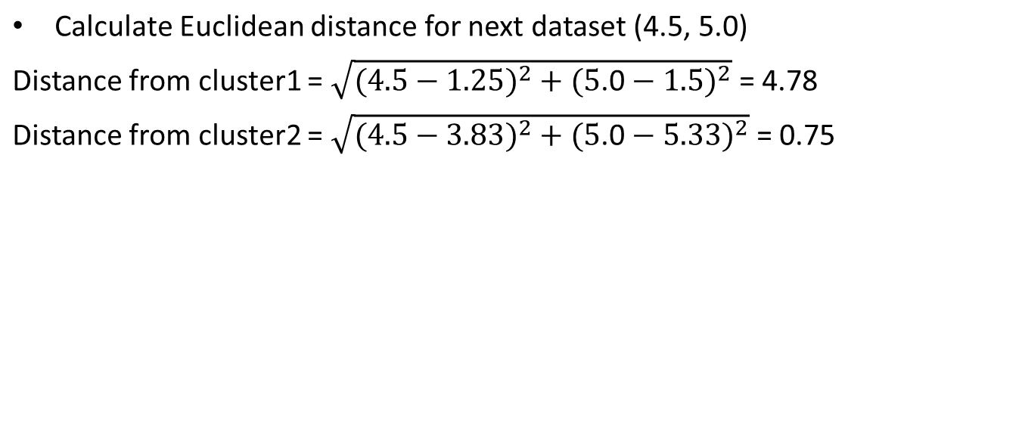
K-Means clustering example
Individual | Variable 1 | Variable 2
1 | 1.0 | 1.0
2 | 1.5 | 2.0
3 | 3.0 | 4.0
4 | 5.0 | 7.0
5 | 3.5 | 5.0
6 | 4.5 | 5.0
7 | 3.5 | 4.5
Dataset | Euclidean Distance
 | Cluster 1 | Cluster 2 | Assignment
(4.5, 5.0) | 4.78 | 0.75 | K- 2

Slide 49

8.00
Variable 2
 |  |  |  |  | 4
 |  |  | 5 | 6
 |  |  | 7 3
 | 2
1
7.00
6.00
5.00
4.00
3.00
2.00
1.00
0.00
0.00
1.00
2.00
3.00
4.00
5.00
6.00

Slide 50
K-Means clustering example
Update the cluster centroid
Cluster | Var1 | Var2
K1 | 1.25 | 1.5
K2 | (3.0+5.0+3.5+4.5)/4= 4.00 | (4.0+7.0+5.0+5.0)/4= 5.25

Slide 51
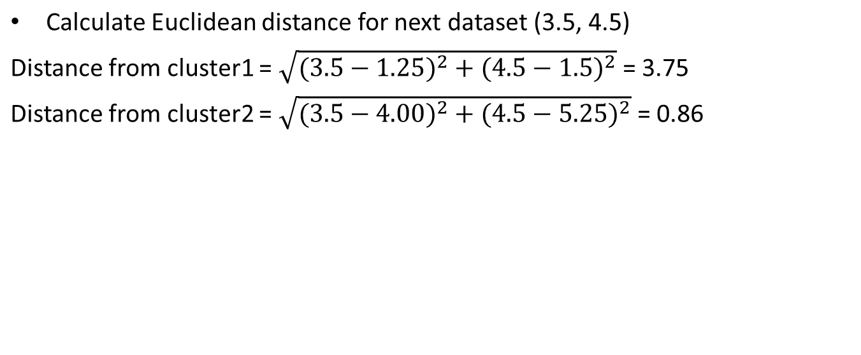
K-Means clustering example
Individual | Variable 1 | Variable 2
1 | 1.0 | 1.0
2 | 1.5 | 2.0
3 | 3.0 | 4.0
4 | 5.0 | 7.0
5 | 3.5 | 5.0
6 | 4.5 | 5.0
7 | 3.5 | 4.5
Dataset | Euclidean Distance
 | Cluster 1 | Cluster 2 | Assignment
(3.5, 4.5) | 3.75 | 0.86 | K-2

Slide 52
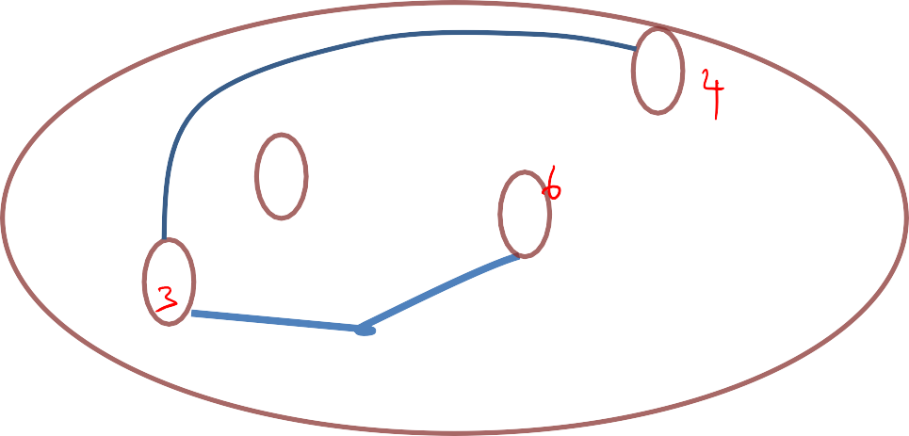

Variable 2
8.00
7.00
6.00
5.00
4.00
3.00
2.00
1.00
0.00
 |  |  |  |  | 4
 |  |  | 5 | 6
 |  |  | 7 3
 | 2
1
0.00
1.00
2.00
3.00
4.00
5.00
6.00

Slide 53
K-Means clustering example
Update the cluster centroid
Cluster | Var1 | Var2
K1 | 1.25 | 1.5
K2 | (3.0+5.0+3.5+4.5+3.5)/5= 3.9 | (4.0+7.0+5.0+5.0+4.5)/5= 5.1

Slide 54
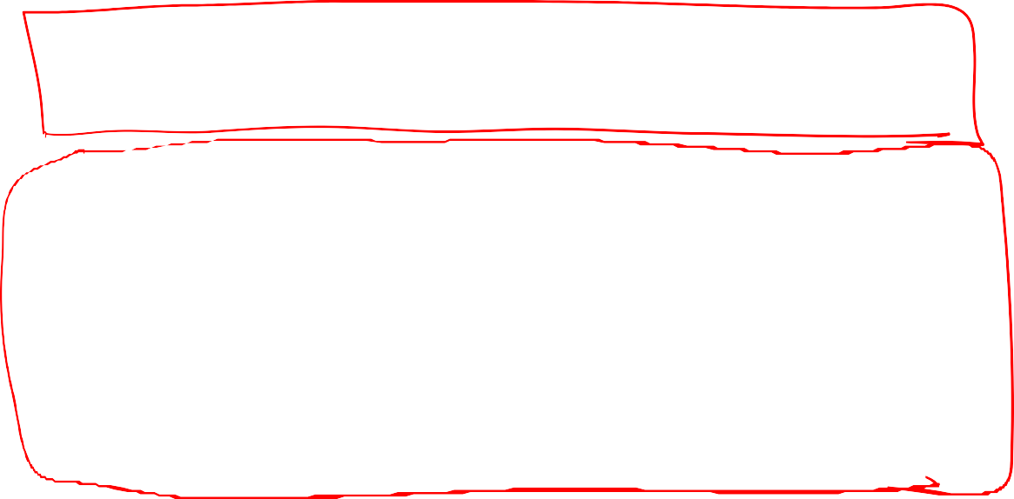
K-Means clustering example
Individual | Variable 1 | Variable 2 | Assignment
1 | 1.0 | 1.0 | 1
2 | 1.5 | 2.0 | 1
3 | 3.0 | 4.0 | 2
4 | 5.0 | 7.0 | 2
5 | 3.5 | 5.0 | 2
6 | 4.5 | 5.0 | 2
7 | 3.5 | 4.5 | 2

Slide 55
How to choose number of clusters
(Imp)

Slide 56
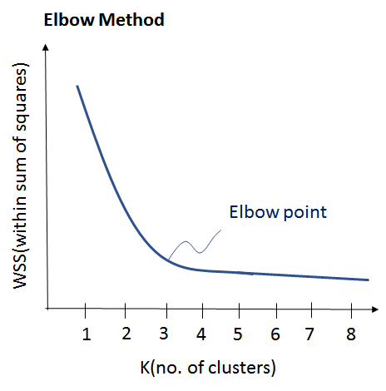
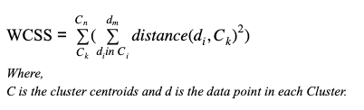
Now, the important question is how should you choose the optimum number of clusters? There are two possible ways for choosing the number of clusters.
(i) Elbow Method: Here, you draw a curve between WSS (within sum of squares) and the number of clusters. It is called elbow method because the curve looks like a human arm and the elbow point gives us the optimum number of clusters. As you can see that after the elbow point, there is a very slow change in the value of WSS, so you should take the elbow point value as the final number of clusters.

Slide 57
(ii) Purpose Based: You can run k-means clustering algorithm to get different clusters based on a variety of purposes. You can partition the data on different metrics and see how well it performs for that particular case. Let’s take an example of marketing T-shirts of different sizes. You can partition the dataset into different number of clusters depending upon the purpose that you want to meet. In the following example, I have taken two different criteria, price and comfort.
.

Slide 58
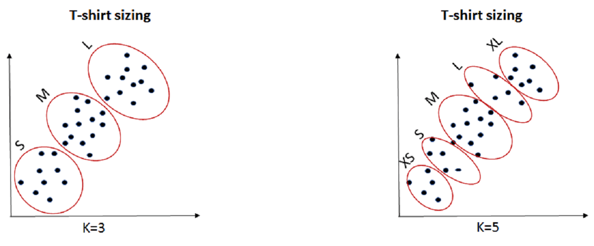
1. K=3: If you want to provide only 3 sizes(S, M, L) so that prices are cheaper, you will divide the data set into 3 clusters.
K=5: Now, if you want to provide more comfort and variety to your customers with more sizes (XS, S, M, L, XL), then you will divide the data set into 5 clusters.
Now, once we have the value of k with us, let’s understand it’s execution.

Slide 59
silhouette score
The silhouette score of 1 means that the clusters are very dense and nicely separated.
The score of 0 means that clusters are overlapping.
The score of less than 0 means that data belonging to clusters may be wrong/incorrect

Slide 60
References
k-Means Advantages and Disadvantages | Machine Learning | Google for Developers
Kmeans Clustering (youtube.com)

Slide 61
Thank you

